Slide 1
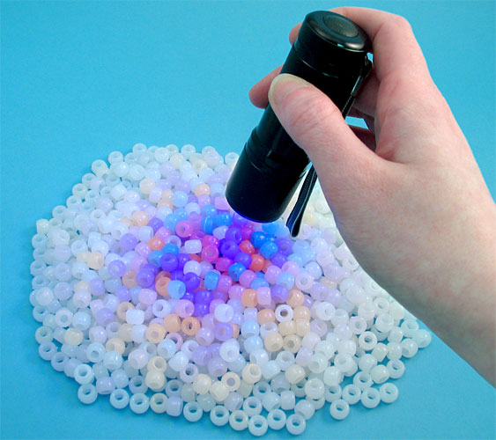
Lab 9: Forensic Techniques
Forensic Analysis: Forensic tests are done for the purpose of presenting results in a court of law or for use in public debate. However, the techniques that forensic scientists use can be useful for many kinds of evidence gathering at work, home, or in the field. In other words, we often encounter the need to understand what’s going on so that something can be fixed or a mystery can be solved. For example, when something goes wrong our car, we are like detectives trying to figure out what it is. Forensic techniques can be useful for that. Our eyes are good for looking for evidence but some things are not always visible. That’s where scientific tools are used to help us see more. A common tool used in forensics investigation is an ultraviolet flashlight or UV laser. These can make substances that are normally invisible glow (fluoresce) so that they can easily be seen.

Slide 2
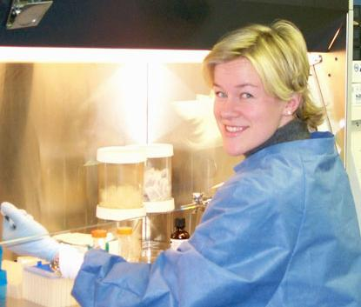
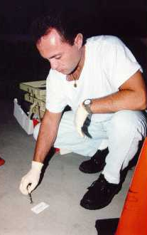
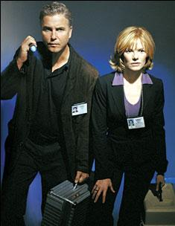
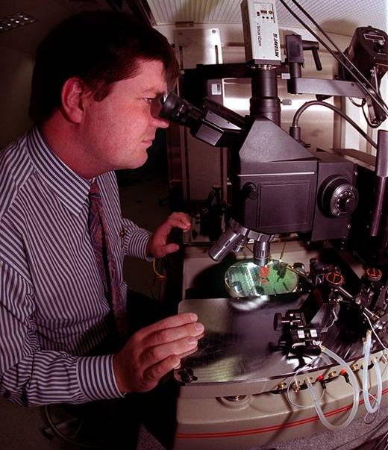
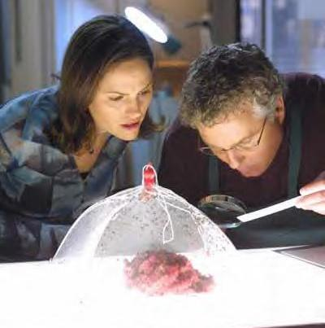
Forensic Techniques
Forensic tests are done for the purpose of presenting results in a court of law. However, the techniques that forensic scientists use can be useful for many kinds of evidence gathering at work, home, or in the field.

Slide 3
Approach
Take advantage of the fact that there is always some exchange of physical evidence between criminal and the crime scene
Either criminal leaves something at the crime scene that can be connected to him/her...
Or criminal picks up something at the crime scene that connects him/her to the scene.

Slide 4
Evidence Examination
The “physical match” is the strongest form of evidence.
It is strong because of the certainty of connecting suspect to crime scene.
In the court it is more convincing because of the obvious visible match.

Slide 5
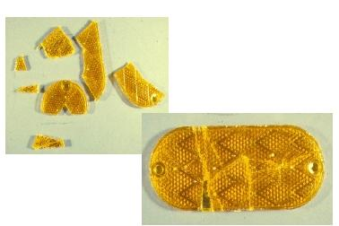
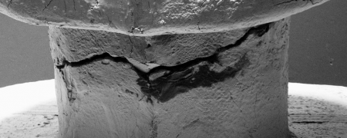
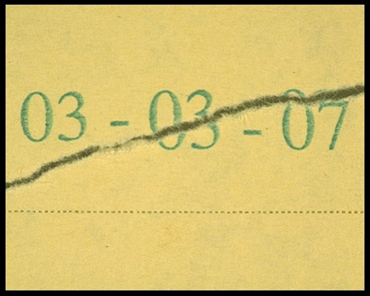
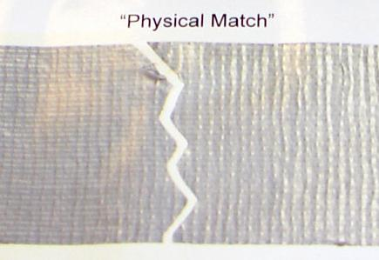
Physical Match

Slide 6
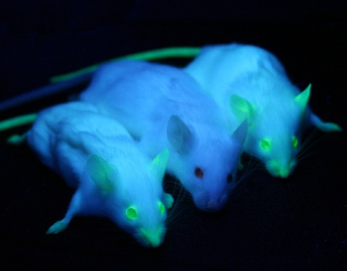
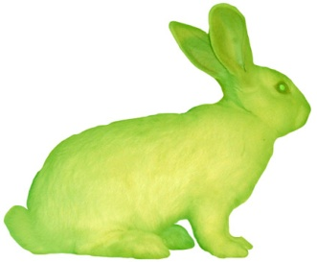
Fluorescence: Making things glow aids in investigation. Biologists have inserted genes that make jellyfish glow into other animals. That makes other animals glow in certain areas or all over. The ability to make something that has no color into something that has color or glows is a useful tool in biology and other sciences.

Slide 7
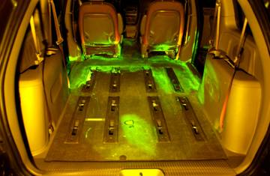
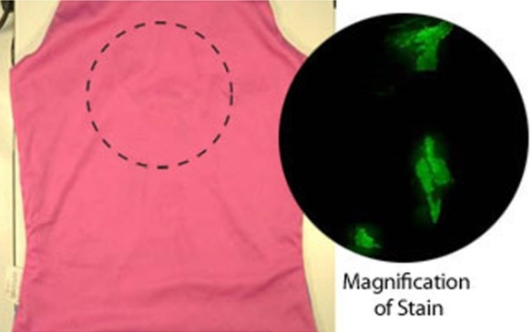
Fluorescence: Forensic investigators use a dye called fluorescein to cause traces of blood to glow.

Slide 8
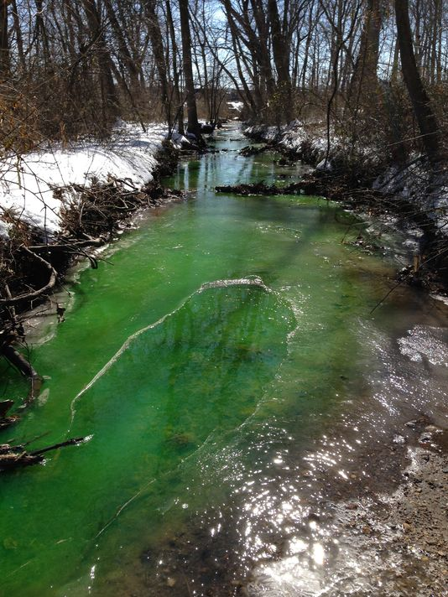
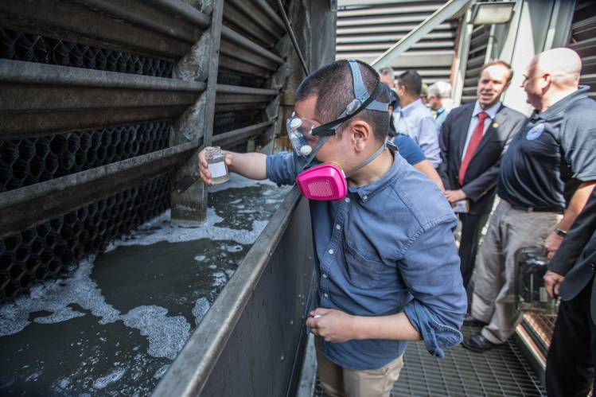
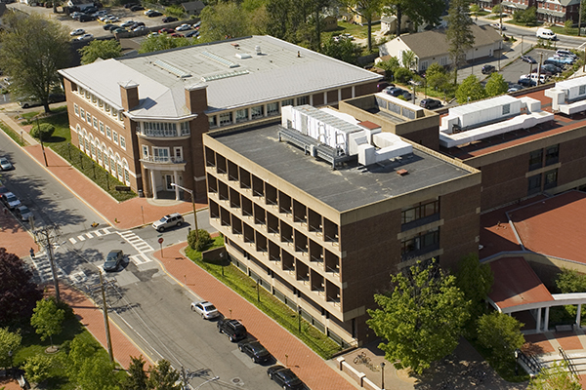
Fluorescein placed in water can track leaks and water pollution.
A University of Delaware building cooling system turned some small waterways around Newark bright green late Monday and Tuesday. About 500 gallons of chilled water containing a fluorescent green dye used for leak detection along with a rust inhibitor leaked from a system at Purnell Hall.
A similar type of leak earlier this month turned streams green near a Chesterfield, Virginia, county jail, according to Homeland Security. Cleanup crews collected 20,000 gallons of polluted water after that incident, according to the federal agency.

Slide 9
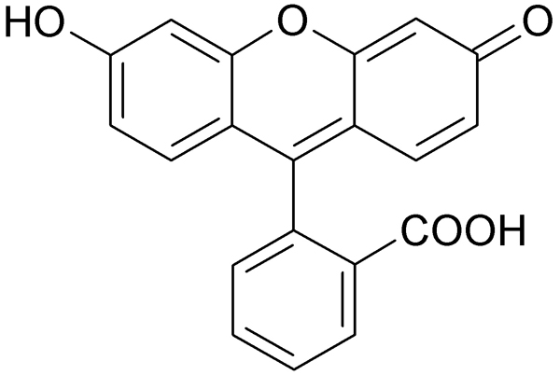
Fluorescein is only slightly soluble in water but soluble in oil.
Na-
Fluorescein disodium is very soluble in water but not in oil.
-Na

Slide 10
FLUORESCEIN
Ultraviolet
Infrared
Near
Mid
Near
Far
Mid & Long
Short
A
Extreme
B
C
Far
Vacuum
10nm
700nm
280nm
121nm
650nm
600nm
550nm
500nm
450nm
400nm
200nm
3,000nm
315nm
15,000nm
1,400nm
1,000,000nm
Peak emission 521 nm
Peak absorption 494 nm

Slide 11
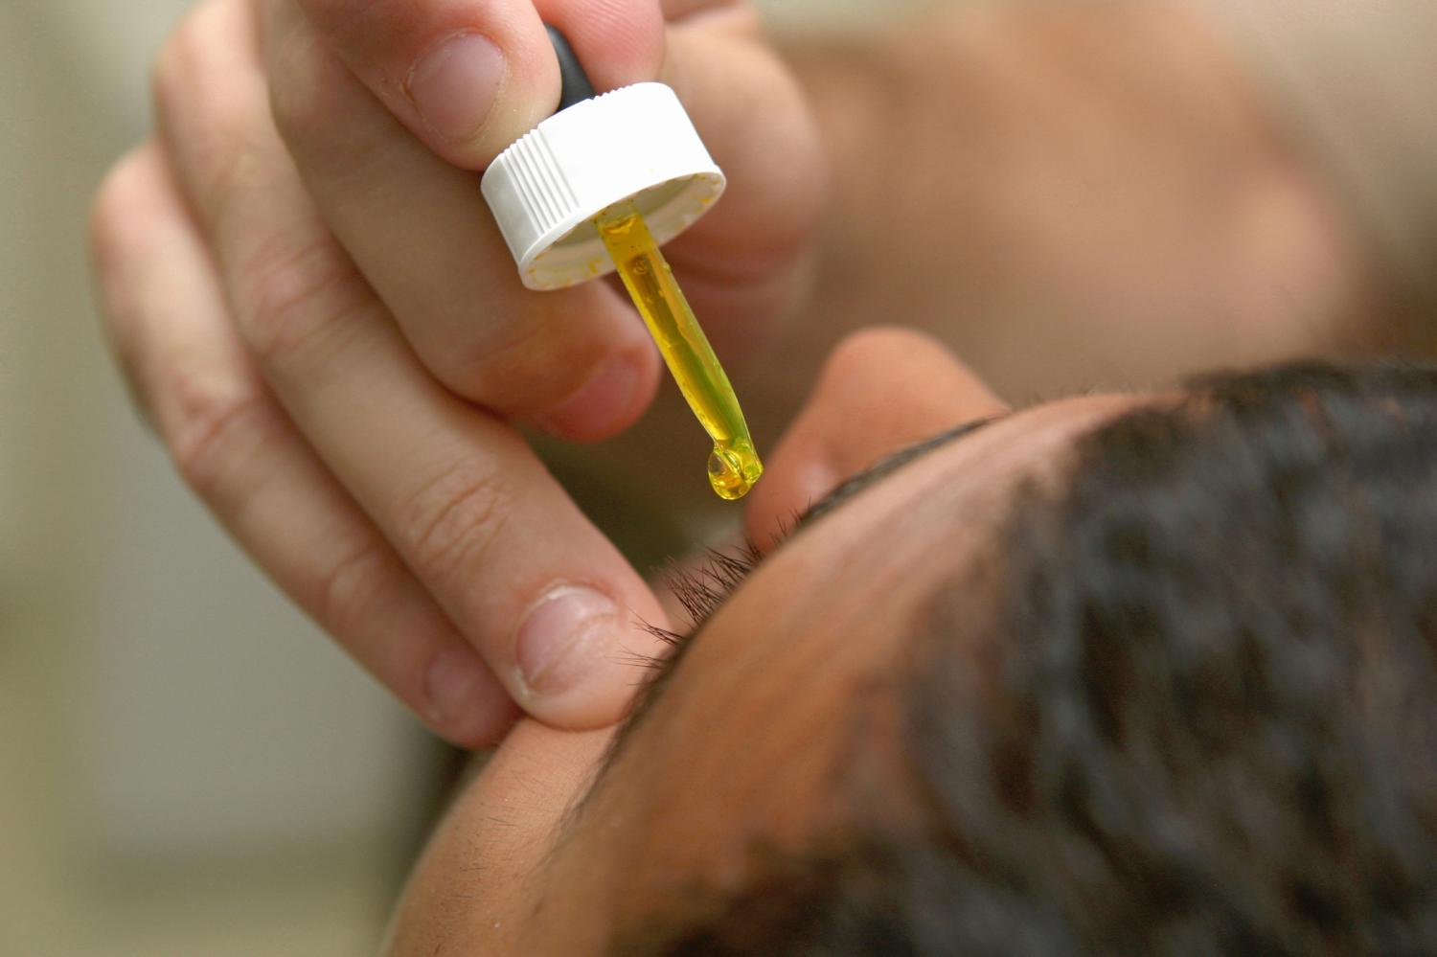
FLUORESCEIN EYE DROPS

Slide 12
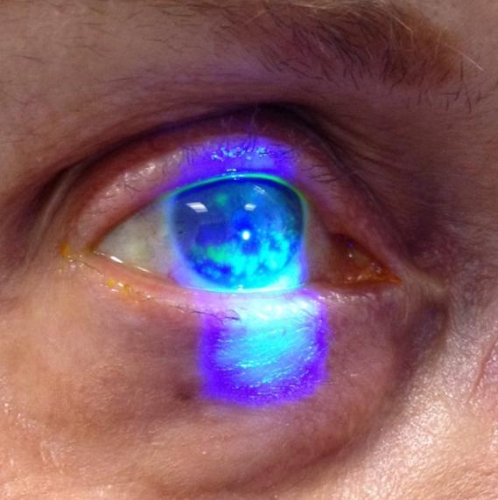
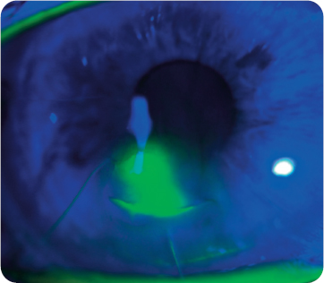
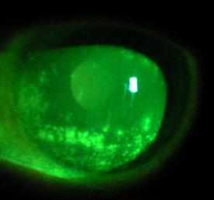
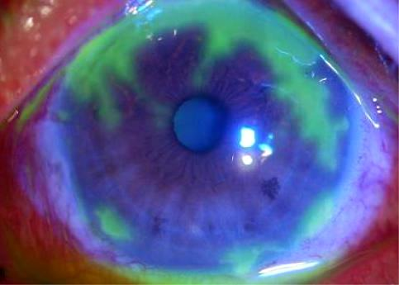
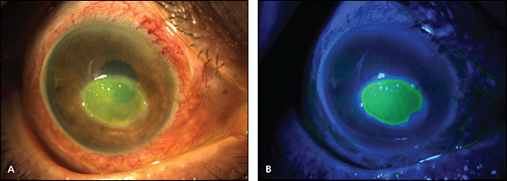

Slide 13
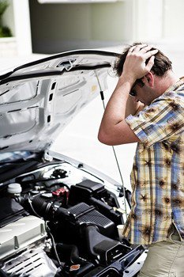
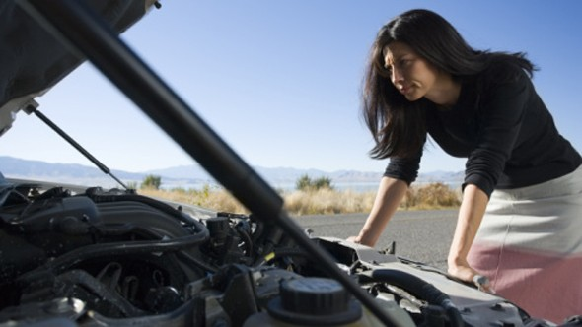
When something goes wrong our car, we are like detectives trying to figure out what it is. Forensic techniques can be useful for that. Our eyes are good for looking for evidence but some things are not always visible. That’s where scientific tools are used to help us see more.

Slide 14
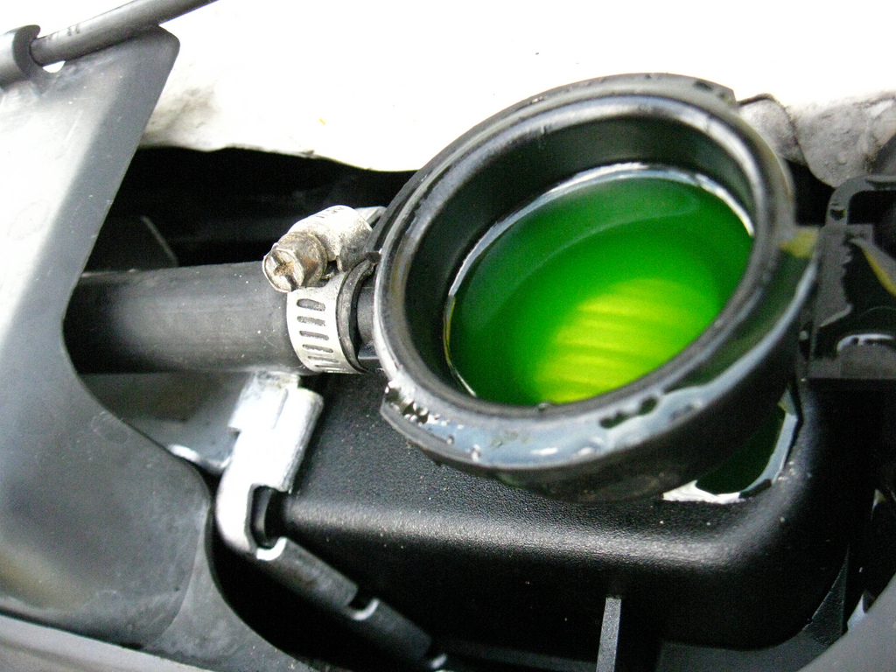

Slide 15
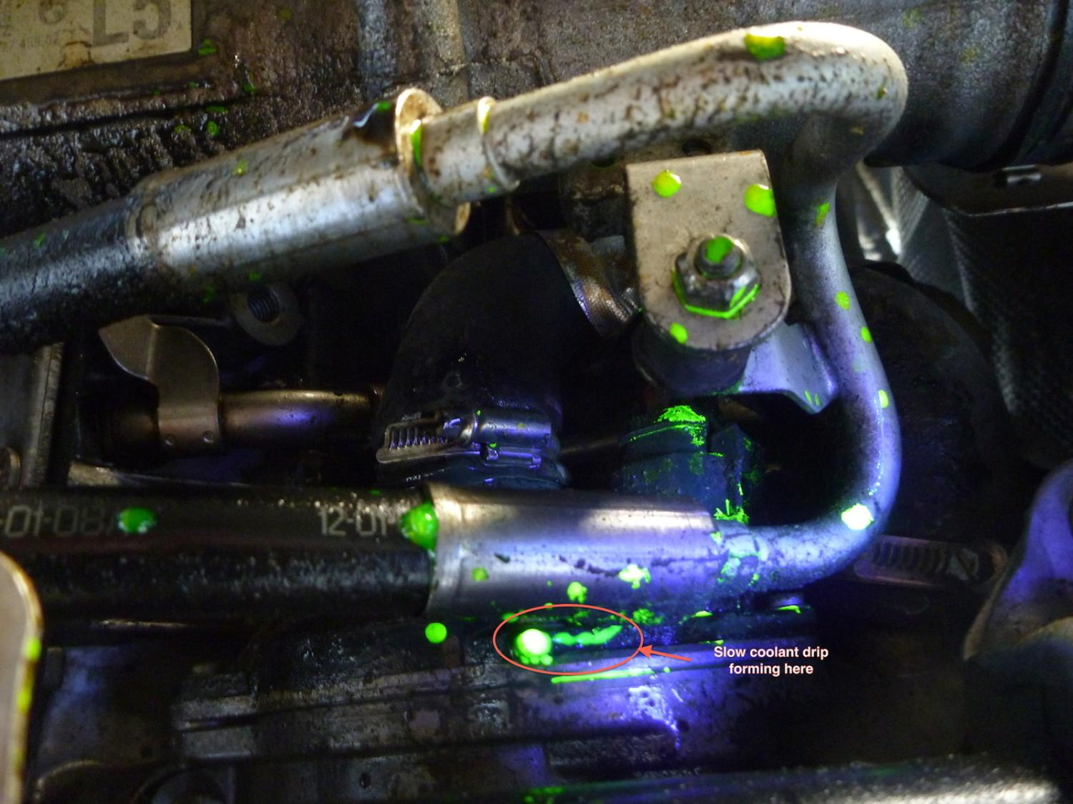

Slide 16
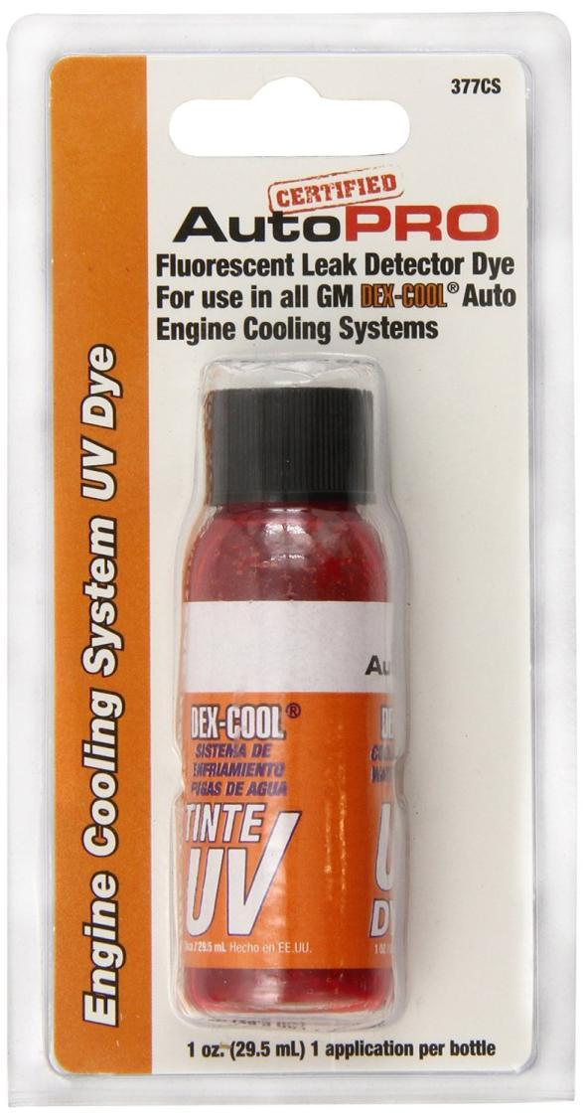

Slide 17
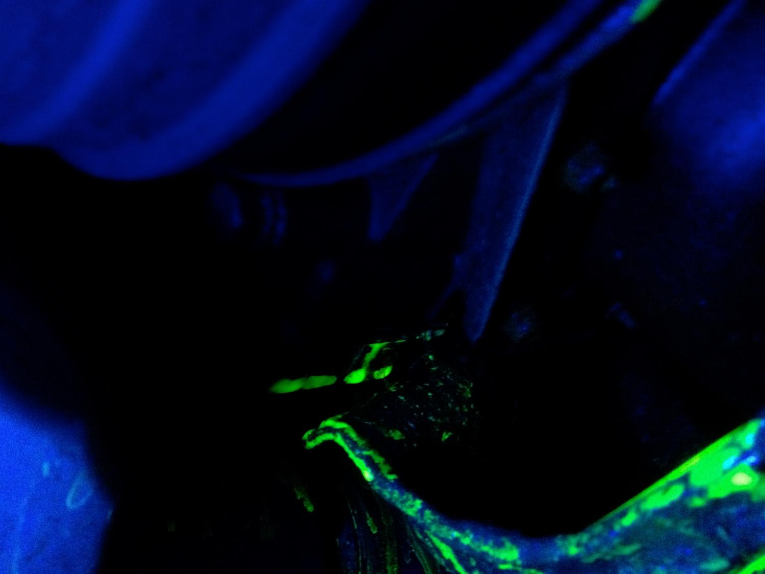

Slide 18
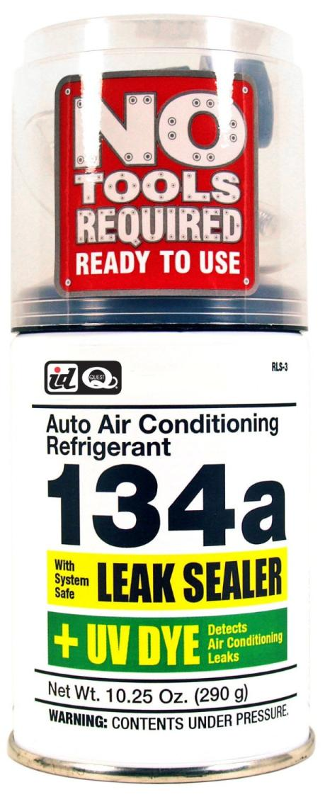
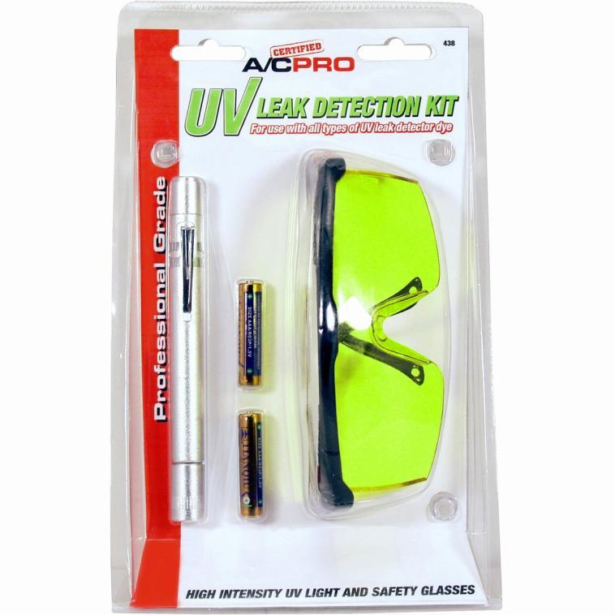

Slide 19
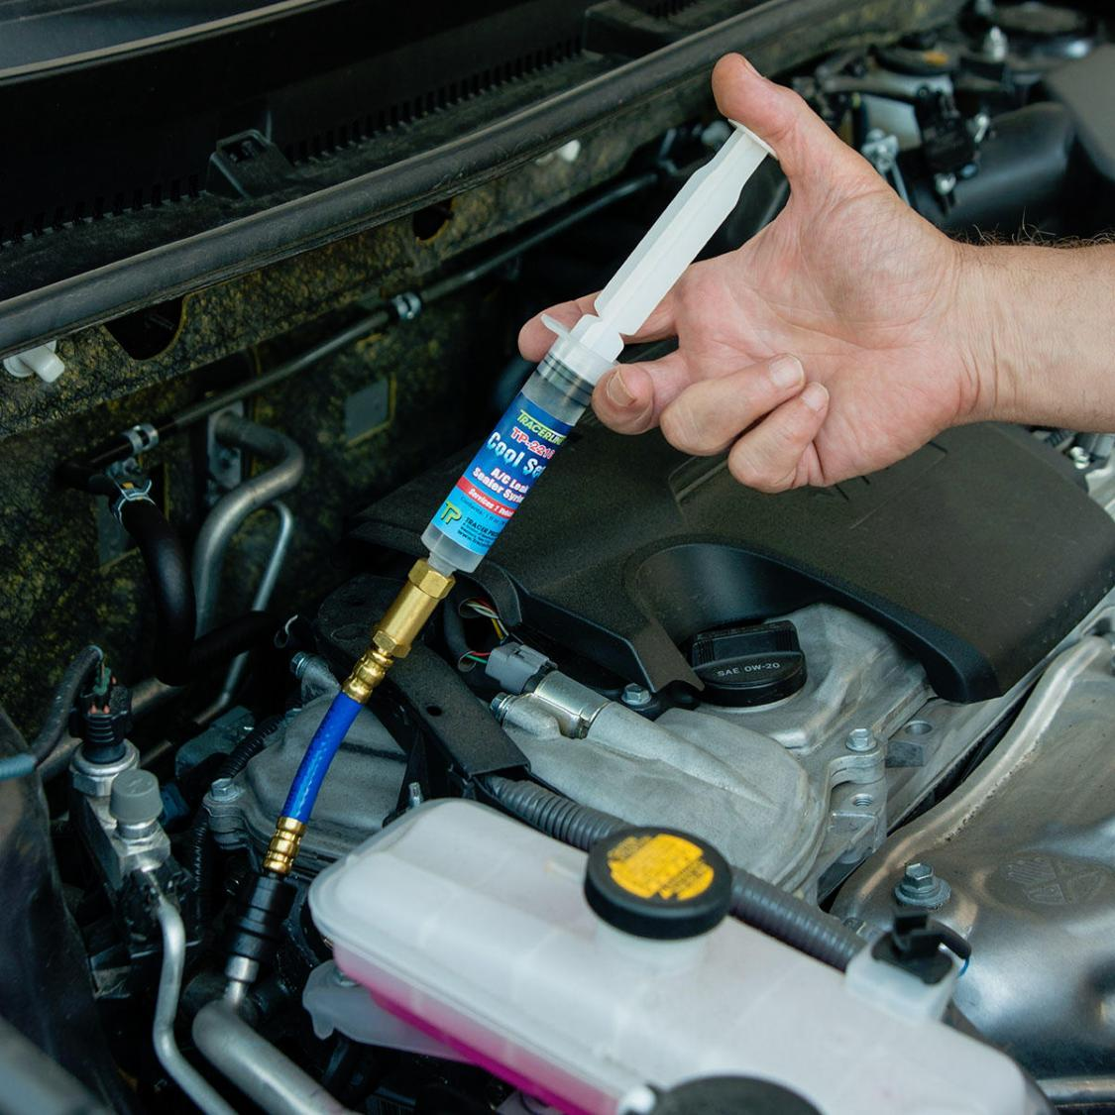

Slide 20
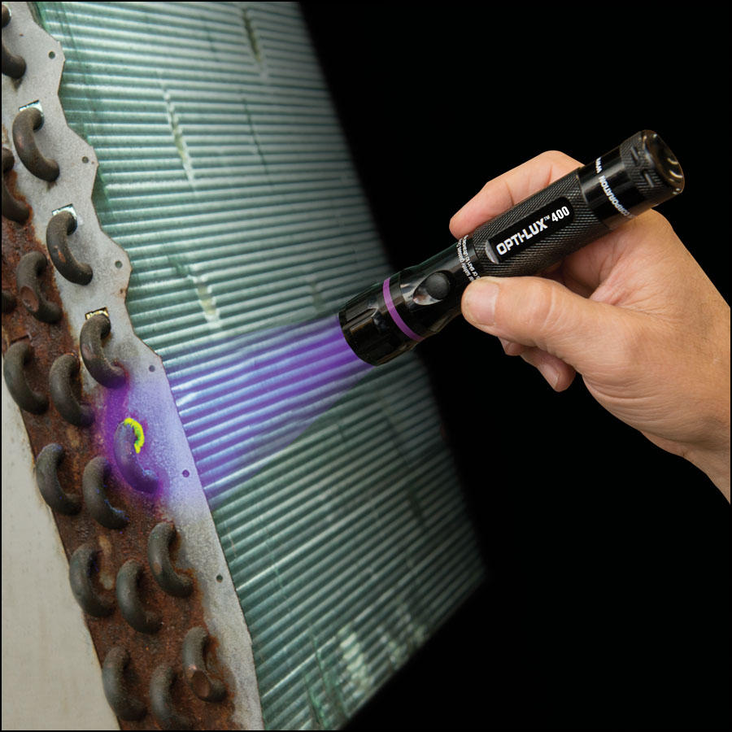

Slide 21
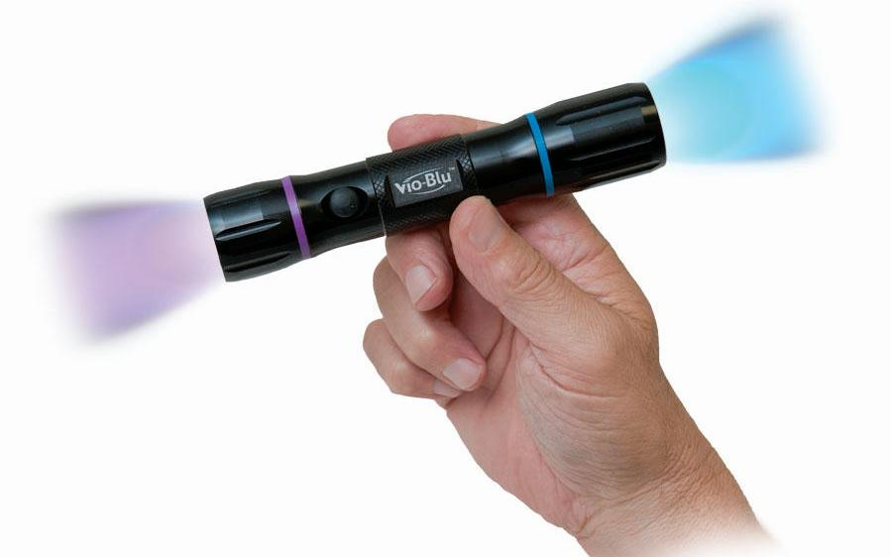
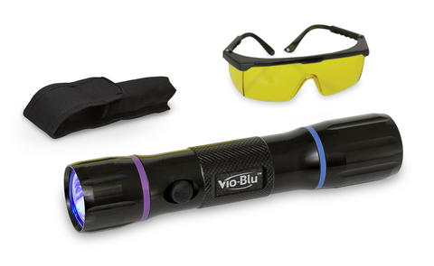

Slide 22
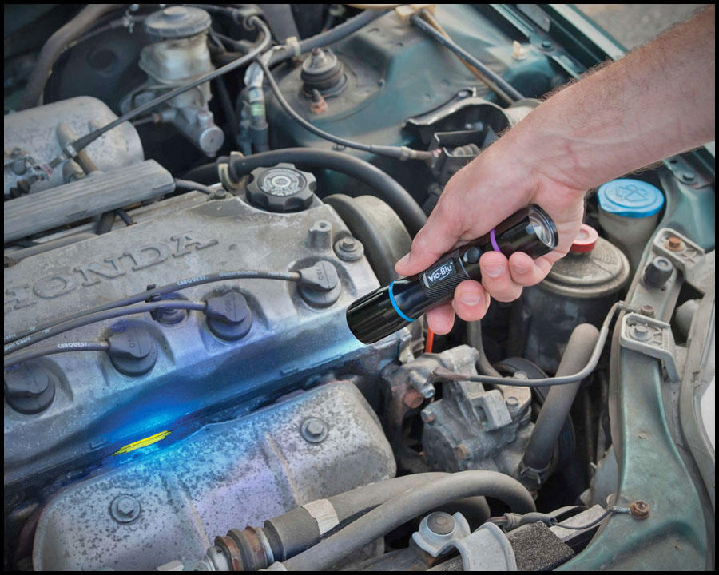
Yellow dye trace pinpoints valve cover oil leak under Vio-Blu’s blue light LED

Slide 23
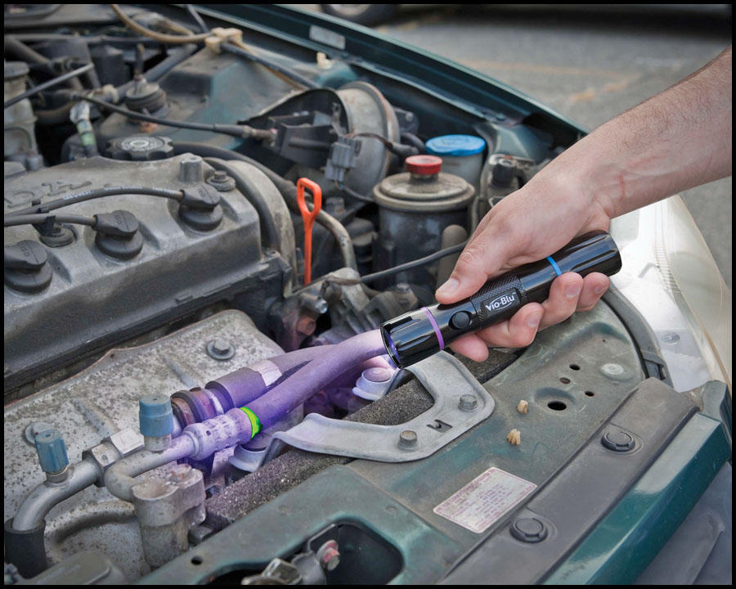
A/C system leak fluorescing a brilliant green under Vio-Blu’s UV LED

Slide 24
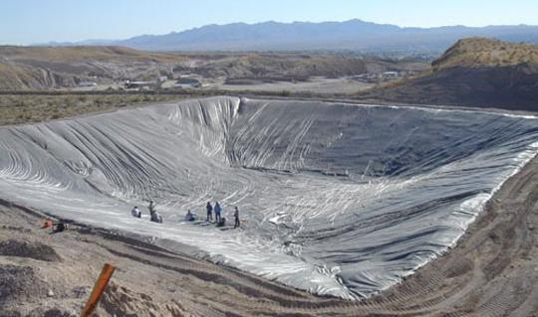
Detection of Holding Pond Leaks: Holding ponds are reservoirs that store polluted run-off water such as waste water from mines or from animal waste on cattle, chicken, and pig farms. The holding ponds are supposed to be sealed so that polluted water cannot leak out into the environment. Sometimes the leak is obvious but other times it is hidden. Fluorescein can be used to detect the hidden leaks.

Slide 25
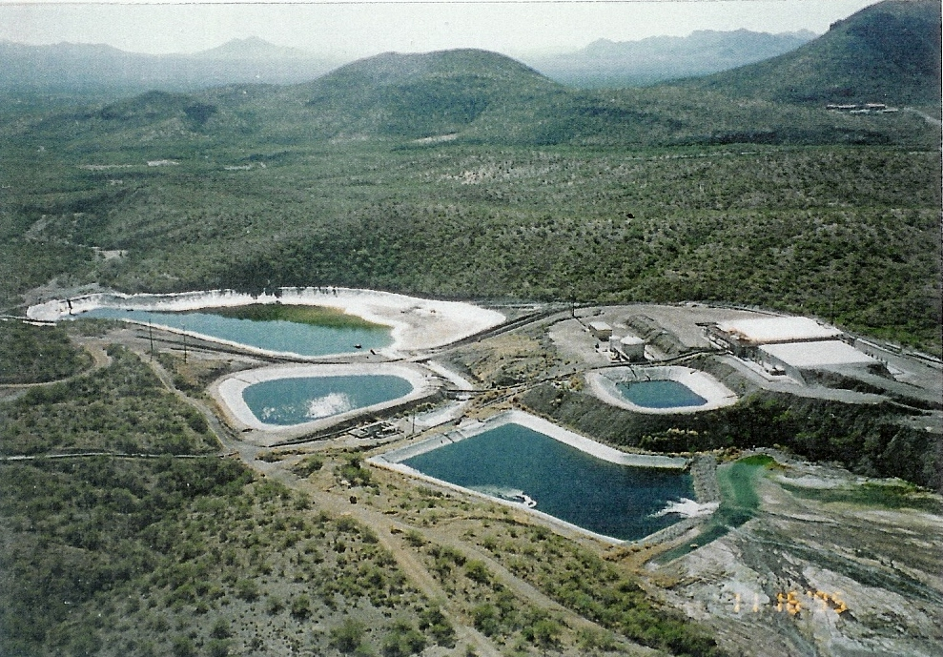
Holding ponds for sulfuric acid in mining.

Slide 26
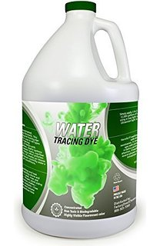
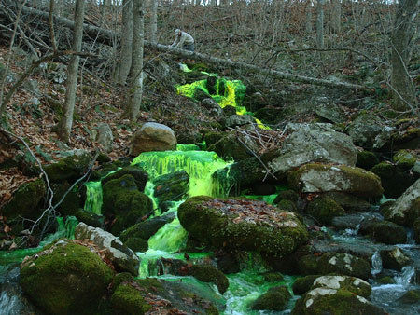
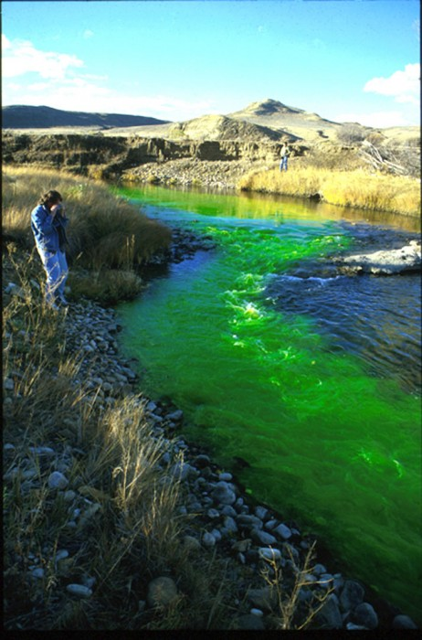
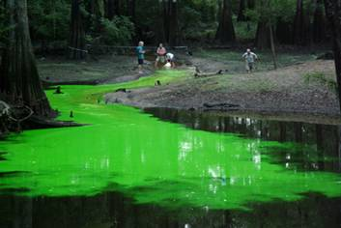

Slide 27
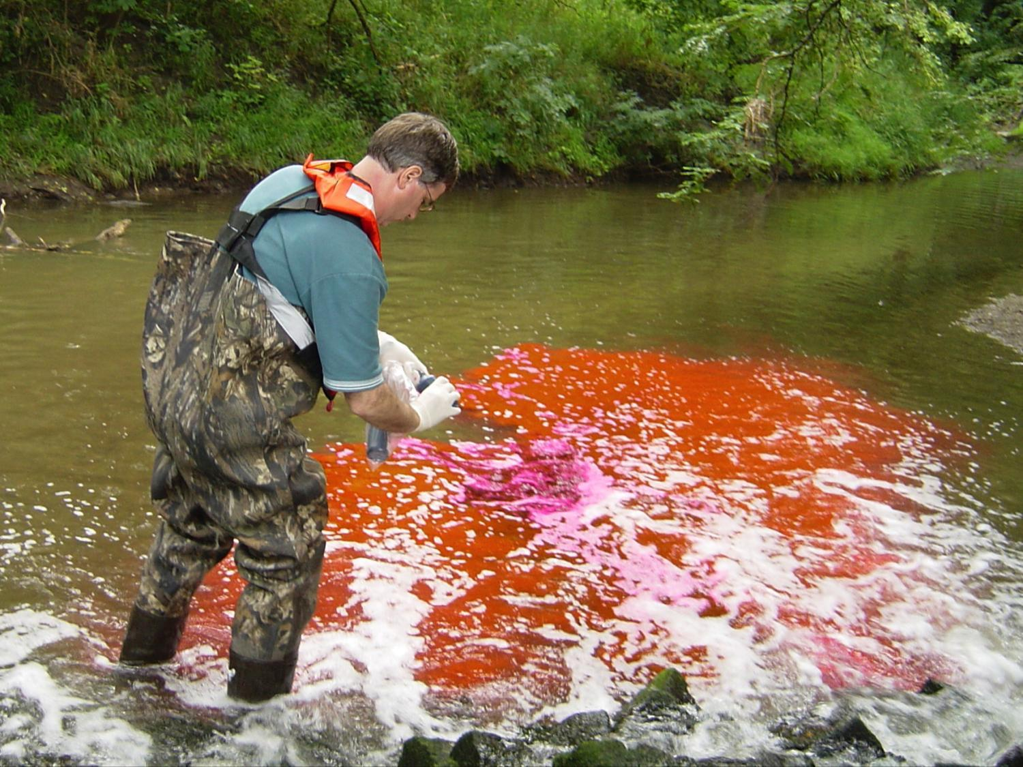

Slide 28
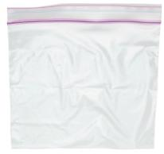
You will use a Ziploc bag to represent a lined holding tank. A Ziploc bag (like a good holding pond) supposedly keeps its contents sealed in the bag. You will check to see if your Ziploc bag truly does that.
Place 100 mL of water into a sandwich size Ziploc bag.
Add 6 drops of the concentrated Fluorescein solution then seal the bag.
Check outside of the bag with an UV light to make sure no Fluorescein is on the outside of the bag.
Measure out about 250 mL of distilled water (or tap water). Add the water to the larger Ziploc bag. Place the small Ziploc bag with the Fluorescein into the large (quart size) Ziploc bag.
Gently rock the large Ziploc bag back and forth for about a minute, then let it sit for about another 10 minutes.
Remove the small inner Ziploc bag from the larger Ziploc bag.
Shoot the purple laser beam through the larger bag to see if the beam is yellow-green. If so, the smaller inner Ziploc bag leaked.

Slide 29
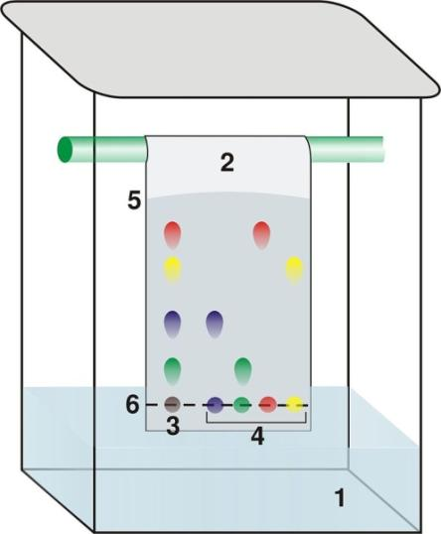
Thin Layer Chromatography (TLC): In forensics, identification of certain drugs or comparison of inks and other substances are often done with thin layer chromatography. The setup for TLC is relatively simple. It involves placing samples on paper (or other thin layer material) and allowing solvent such as water/alcohol mixture to climb up the paper. As it does, the components in the sample will travel at different speeds. This causes them to separate. So samples that initially look the same will be shown to be different if they produce spots of different colors or spots at different heights. Thin layer chromatography works best with colored samples (hence the name “chroma”); however, UV light can make some non-visible components of the sample glow and be visible.

Slide 31
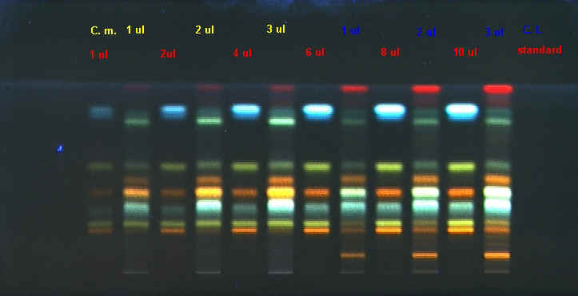
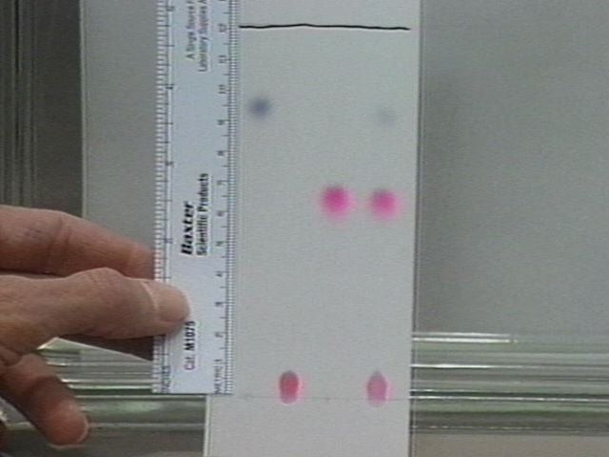

Slide 32
Connecting suspect to crime using Thin Layer Chromatography : In some crime investigations, the question of who did some writing is key (like who wrote a check or who wrote a ransom note). The strategy is to see if the pen that did the writing is the same pen that a suspect is carrying. This can be done by seeing if the inks match.
9” x 5” sheet
. . . . . . . . . .
1.5”
unk 1 2 3 4 5 6 7 8 9
2.5”
1) Cut a sheet of paper to 9” by 5”. Draw a line using a pencil 1.5 inches (3.8 cm) from the bottom of the sheet. Starting at 2.5 inches from the left, place dots using a pencil at every half inch along that line. Label them “unk and 1, 2, 3, 4, 5, 6, 7, 8, & 9.
2) On the “unk” (unknown) dot, carefully place a dot of ink from a bottle that contains ink that was extracted from the written evidence (ransom note, check, etc.).

Slide 33
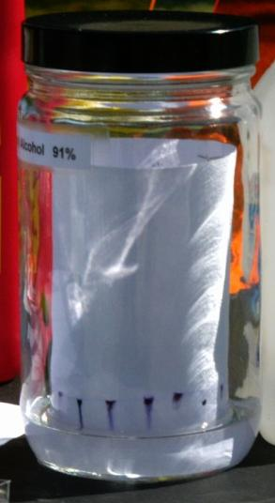
5) Get a chromatography jar and place ¾” of solvent into the jar. The solvent is usually a mixture of rubbing alcohol and water, acetone or water, or some other solvent.
6) Carefully place the sheet of paper (coiled into a cylinder) into the jar with the solvent. Replace the cap.
7) Work on the other parts of this lab while the solvent is climbing up the paper. Wait until the solvent has risen at least half way up the paper before making a conclusion.
At the end of this experiment, the class can compare their chromatographs to see which mixture did the best job in separating the components of the inks.
8) Decide which pen best matches the pen used in the crime, or say no pen was a match. Also, results can be inconclusive if the chromatography did not produce a good separation or distinction between the spots. Let instructor see your results.
Matches Pen #: ______ No Match Inconclusive

Slide 34
Latent (present but not visible) fingerprints: The chemical composition of our fingerprints allows various methods to be used to make them visible.
Oils in our fingerprints are sticky. So powders such as small iron filings will stick to them making them visible.
There is also salt (sodium chloride) in fingerprints. Silver ions in a solution of silver nitrate will latch onto the chloride in the fingerprint producing white particles (silver chloride). Then in sunlight or UV light, the silver ions become metallic silver particles, which are black.
Fingerprints also contain proteins. A chemical called “Ninhydrin” reacts with NH₂ groups on the proteins, which turns Ninhydrin from white to purple. So when sprayed with a dissolved solution of Ninhydrin, the fingerprints become visible as purple prints.
Glues such as “Super Glue” and “Krazy Glue” contain forms of cyanoacrylate. You may have experienced your fingers getting glued together when using Super Glue. Super Glue also sticks to fingerprints because of small amounts of water being present.
Cyanoacrylate

Slide 35
Iron filings and magnet brush

Slide 36
Black powder and brush

Slide 37
Fluorescent powder and feather brush

Slide 38
Ag⁺ + Na⁺ + Cl⁻ → AgCl + Na⁺
2AgCl → 2Ag + Cl₂

Slide 40
Ninhydrin spray turns proteins purple

Slide 42
5) Crystals of iodine are warmed so that they turn to vapor. This is blown across the latent fingerprints. Oils and fats in the prints absorb the iodine vapor and turn black.

Slide 43
Fingerprint technicians place items into a closed container containing cyanoacrylate. When heated, the cyanoacrylate turns to vapors which find their way to the latent fingerprints. The cyanoacrylate reacts with the moisture in the prints to form a white polymer which makes the prints visible. 5) Crystals of iodine are warmed so that they turn to vapor. This is blown across the latent fingerprints. Oils and fats in the prints absorb the iodine vapor and turn black.
The lab will be set up so that you can use one or more of the above methods to “dust” for prints. Show your instructor that you completed one or more of these methods.

